Slide 1
Controlled Magnetic levitation
Objective :
The aim of this project was to investigate magnetic levitation and to design a
working system capable of levitating an magnet from below. The system should be
able to levitate an magnet from below without any form of support. The control
and circuit complexities should be investigated and recommendations for
improving the designed system should be made.

Slide 2
Magnetic levitation is the process of levitating an object by exploiting magnetic fields. If the magnetic force of attraction is used, it is known as magnetic suspension. If magnetic repulsion is used, it is known as magnetic levitation
Feedback: used in conjunction with electromagnets to dynamically adjust magnetic flux in order to maintain levitation
If the object gets too close to th electromagnet, the current in the electromagnet
must be reduced. If the object gets too far, the current to the electromagnet must be increased.
The main driving interest behind electromagnetic levitation is in its applications in mass transport. In its applications in mass transport, particularly trains, this
technology is loosely referred to as MagLev

Slide 3
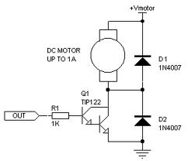
Current drive circuit:

